Slide 1



SMART INDIA HACKATHON 2022

Slide 2
Problem Statement
Develop Solution / Application to regulate Private health care sector in India from exploiting people during medical emergencies and pandemic situations.

Slide 3
During Covid – 19 crisis, many private hospitals had charged huge and unimaginable amounts from patients and made enormous profits taking advantage of panic conditions. Notwithstanding spending huge amounts, many families lost their members and in some instances, hospitals even demanded clearance of pending bills for handing over bodies to their families. There was no proper information about the availability of beds and details of treatment provided etc

Slide 4
SOLUTION
Medical facilities prices provider app is a mobile app designed to provide a solution for the problem of not being able to know the proper price for a particular medical treatment
The app will provide users list of medical facilities available in a particular hospital
In case any hospital charge more than what is mentioned in the app then users can raise complaint about it which is directly sent to the admin

Slide 5
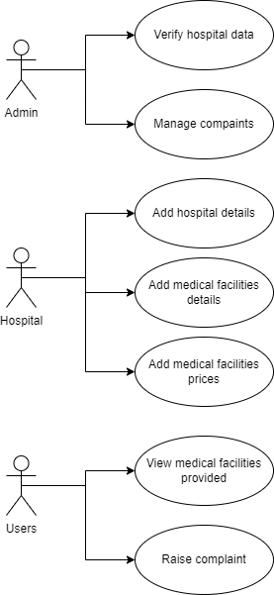
Modules
ADMIN
HOSPITALS
USERS

Slide 6
THANK YOU
GROUP MEMBERS :
SRIMOYEE DUTTA
VAISHALI PATHANIA
AMRUTA KASHIKAR
ADITI BHARADWAJ
HARSHAL JODANGADE
DIVYA WANDHARE

